Slide 1



Microservices: Case Study Audience: All Roles

Slide 2

Case Study
Activity
Purpose | This is supplementary case study to orient the Microservices bootcamp labs around.
Preparation | The labs follow the topics/sub-topics that need to be delivered before attempting the labs.
Process | In labs for SMEs: The SME labs would be pre-implemented labs which can be referred to in the classroom. During classroom training for participants: Participants should be able to build the labs from scratch during the hands on sessions in the classroom.
Product | The labs for all bootcamp tracks are built around the case study to achieve coherence of topics and logical progression between labs for topics.

Slide 3
Domain Overview
Microservices: Case Study
The case study presents a typical eCommerce domain.
The diagram shows the potential bounded contexts and starting points of the Microservices.
The domain presents both synchronous and asynchronous cases. The orchestration of flows between services needs to be as per the training topic.
The same domain can be purely a monolith, a modular monolith, a distributed synchronous Microservices, a distributed event driven Microservice, or a domain-driven design based Microservice depending on the topic of the training.

Slide 4
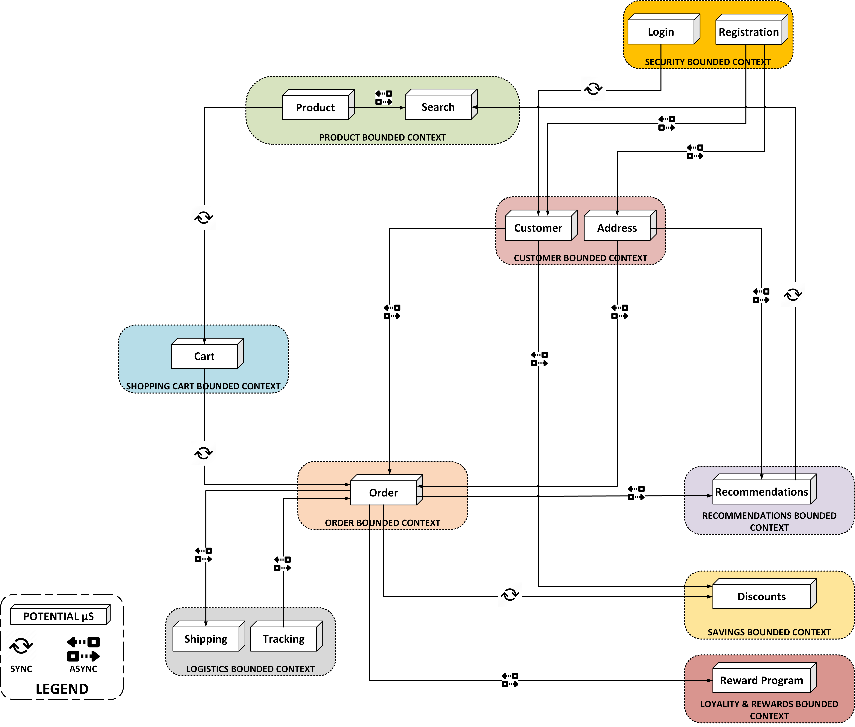
Domain Overview

Slide 5
Domain Details
PRODUCT BOUNDED CONTEXT
Allows for products to be added, archived, and managed in general
Search decorated with user recommendations
CUSTOMER BOUNDED CONTEXT
Provides customer management
Allows for addresses to be captured and updated
SECURITY BOUNDED CONTEXT
Provided authentication and authorization(Role-based)
Allows for products to be searched
Allows for pre-configured payment methods
Emits customer add/update domain events
Provides the basic landing page (SPA or otherwise) post authentication
CART BOUNDED CONTEXT
Provides cart operations as abstraction for shopping actions
Provides the ordering pre-requisites
Publishes line item management APIs.
ORDER BOUNDED CONTEXT
Takes cart state and raises a domain event to fulfil order
Post ordering provides recommendations post the products purchased
Talks to discount service to provide user discounts at cart checkout
Publishes the orders to recommendation service to update the loyalty and rewards
LOGISTICS BOUNDED CONTEXT
Takes the order domain event and prepares the inventory for shipping
Provided APIs to track the order delivery and updates the order state with the same asynchronously
RECOMMENDATIONS BOUNDED CONTEXT
Builds recommendation engine as per user preferences, address and previous orders
Provides recommendations during search and post-checkout
SAVINGS BOUNDED CONTEXT
Provides product discounts for a user context
LOYALITY AND REWARDS BOUNDED CONTEXT
Tracks loyalty for a customer and provides rewards
Enables redemption of loyalty and rewards points

Slide 6
Technical Overview

Slide 7
Expectations
Microservices Case Study
The content, while describing a pattern or concept, should make use of the domain (the problems in the domain) to illustrate the problem and the potential solution options.
The code reference in the content should refer to the services and integrations within the domain.
The labs for each of the topics, at whichever stage or track it would be taken up in the bootcamp, should refer to the whole of part of the domain. Ideally, the labs should be built on previous labs, which would be a difficult thing to achieve logistically, since the content and labs are curated for multiple SMEs. So, this domain is looked to keep the references consistent across labs.
Going forward, we might need to keep the database schemas consistent so that the data model is consistent across different labs, even though the services themselves in the labs may not be based on evolution, since these are being developed concurrently.
The datastores, entity modelling, and data flows within and across these Microservices should follow the Microservices patterns.
Though the illustration provides basic hints at the flow, the individual topics in the bootcamp can pick up parts of this domain to illustrate the pattern.
The datastores for the services can be a transaction DB or a projection or a Read Only copy in a separate bounded context.

Slide 8

Q&A

